Slide 1
Arkham Adventure

Slide 2


Slide 3
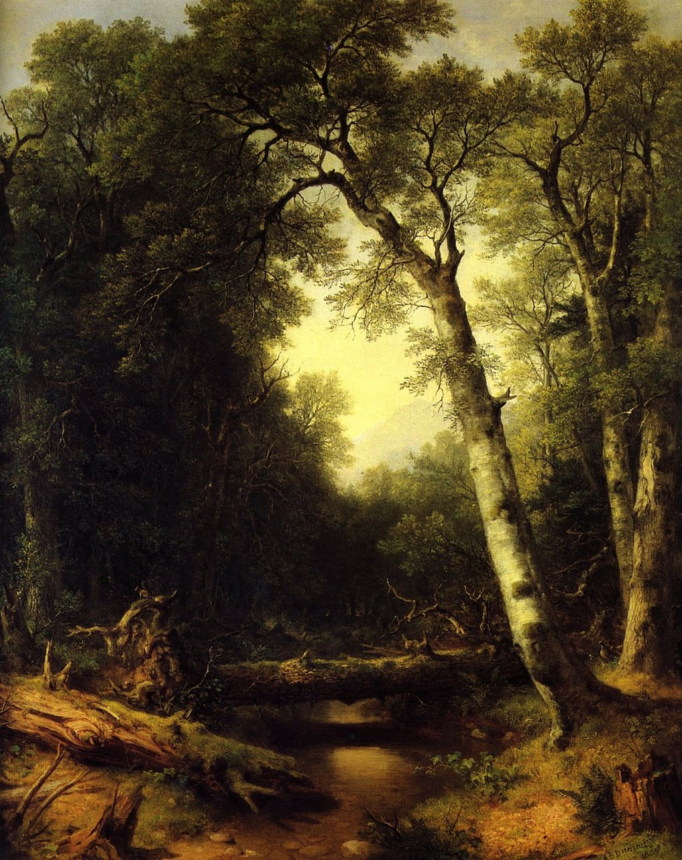

Slide 4
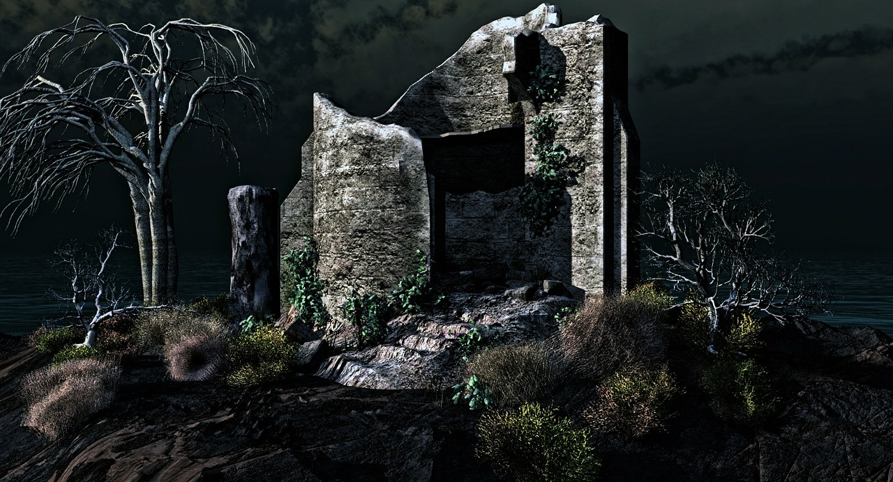
Arkham Adventure

Slide 5
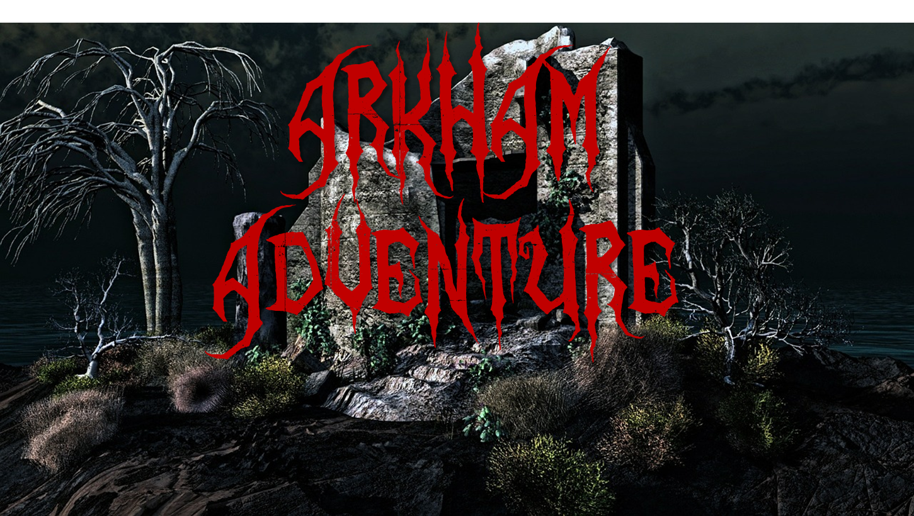

Slide 6
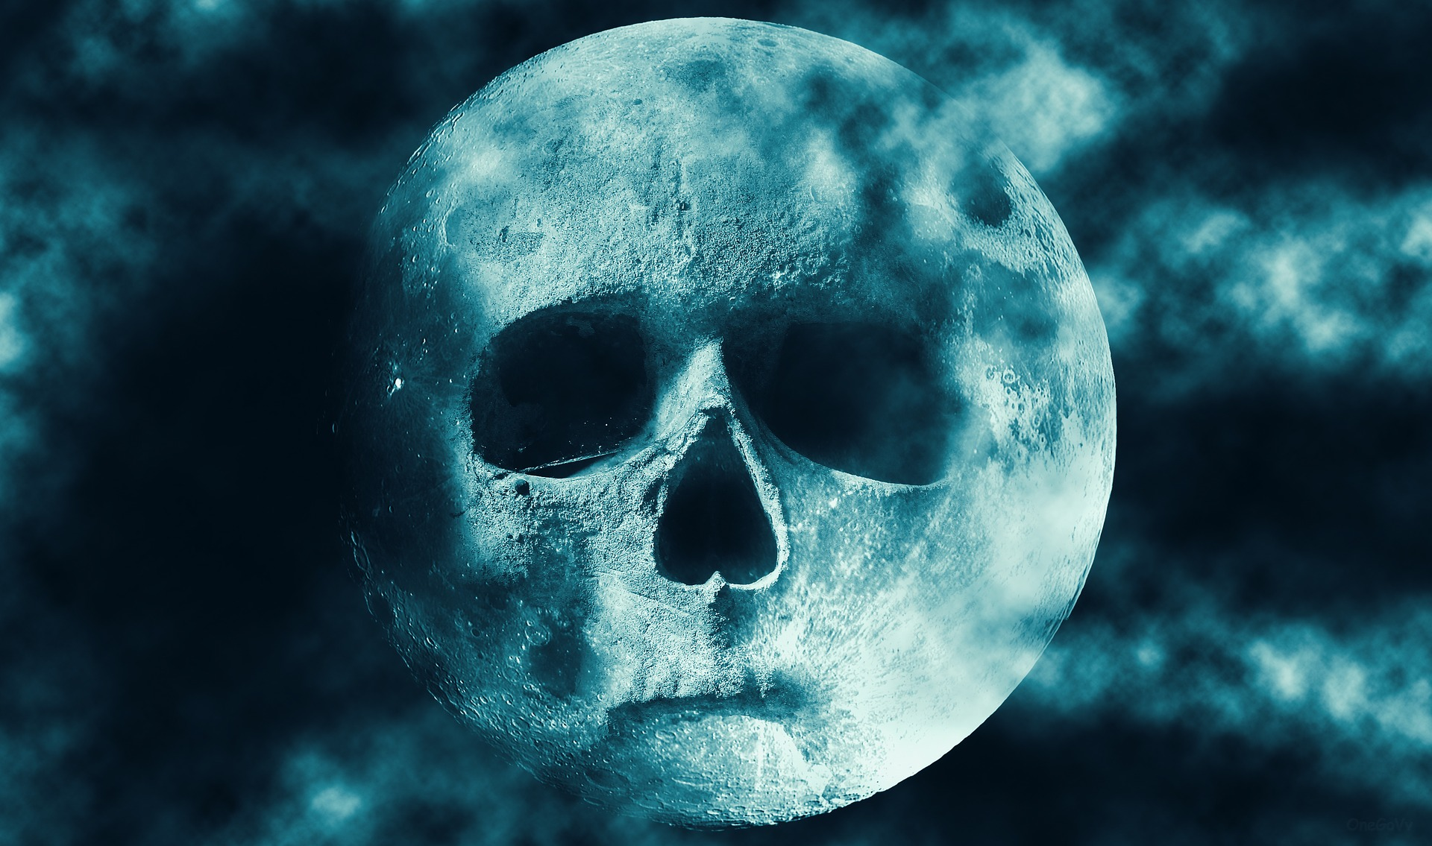
You Have Died

Slide 7
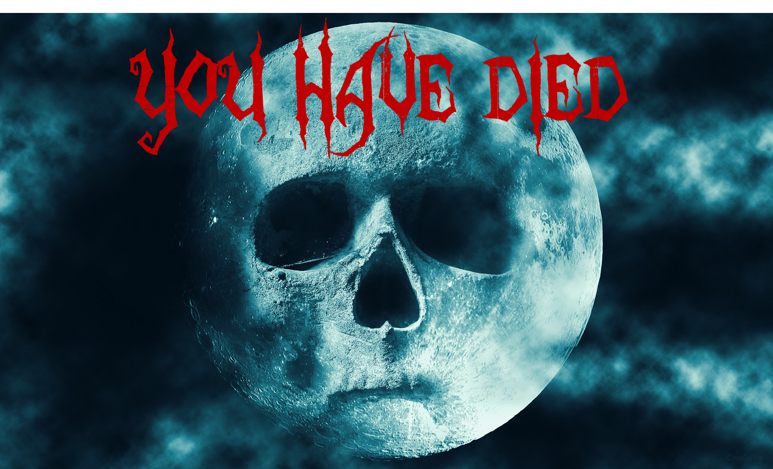

Slide 8

You
Survived…

Slide 9


